Slide 1
615 Final project
Ecommerce Retail Data Analysis
By Qianhui Rong

Slide 2
Contents
Data Preprocess
Data Validity Analysis
EDA on Time
EDA on Country
Text Analysis on Item Descriptions
Marketing Analysis
Modeling

Slide 3
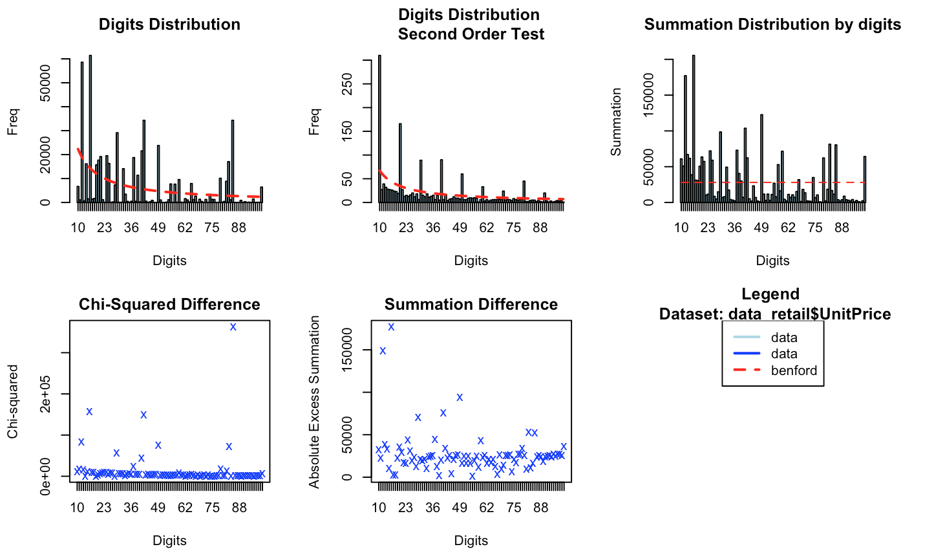
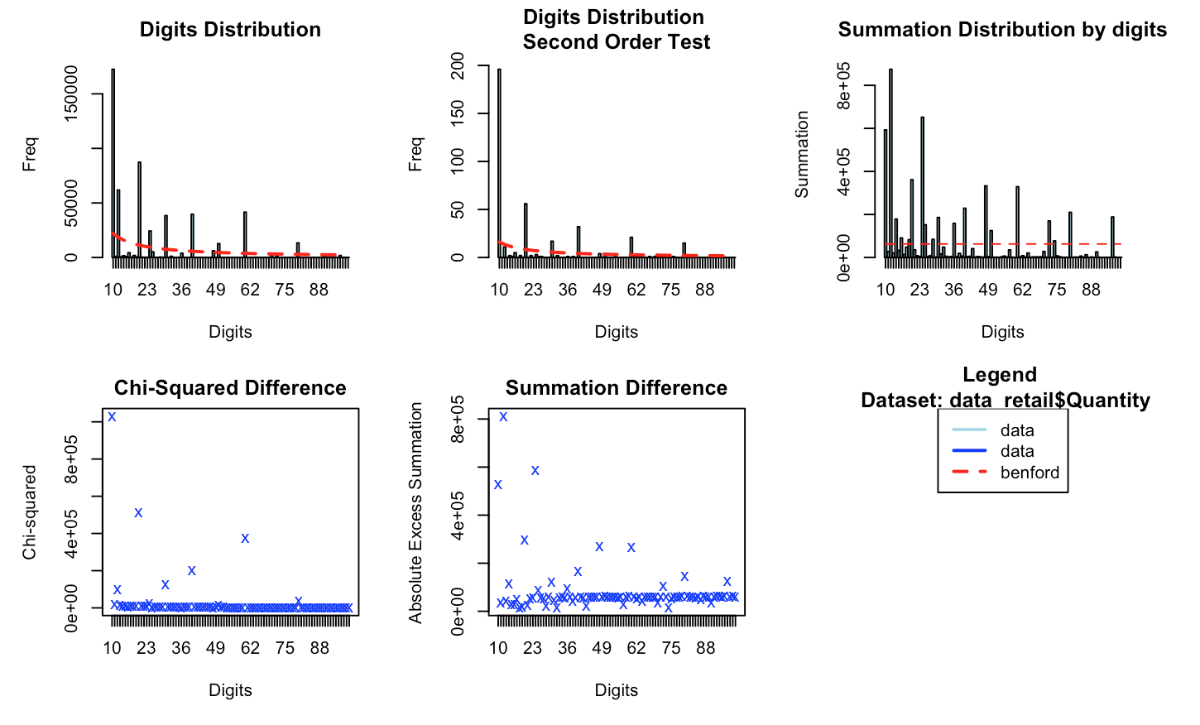
Data Validity Analysis
Unit price and quantity don’t follow Benford Distribution and the difference is large.

Slide 4
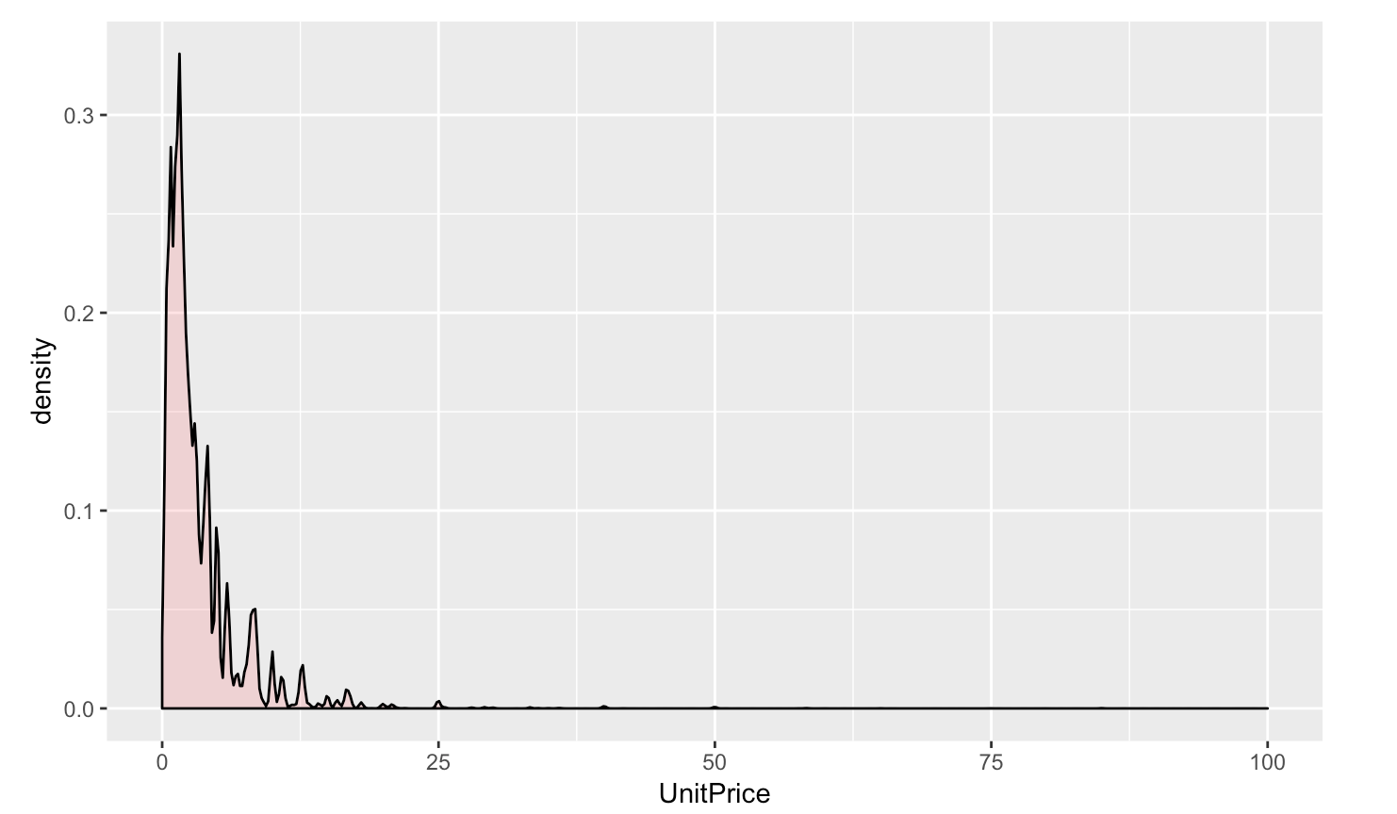
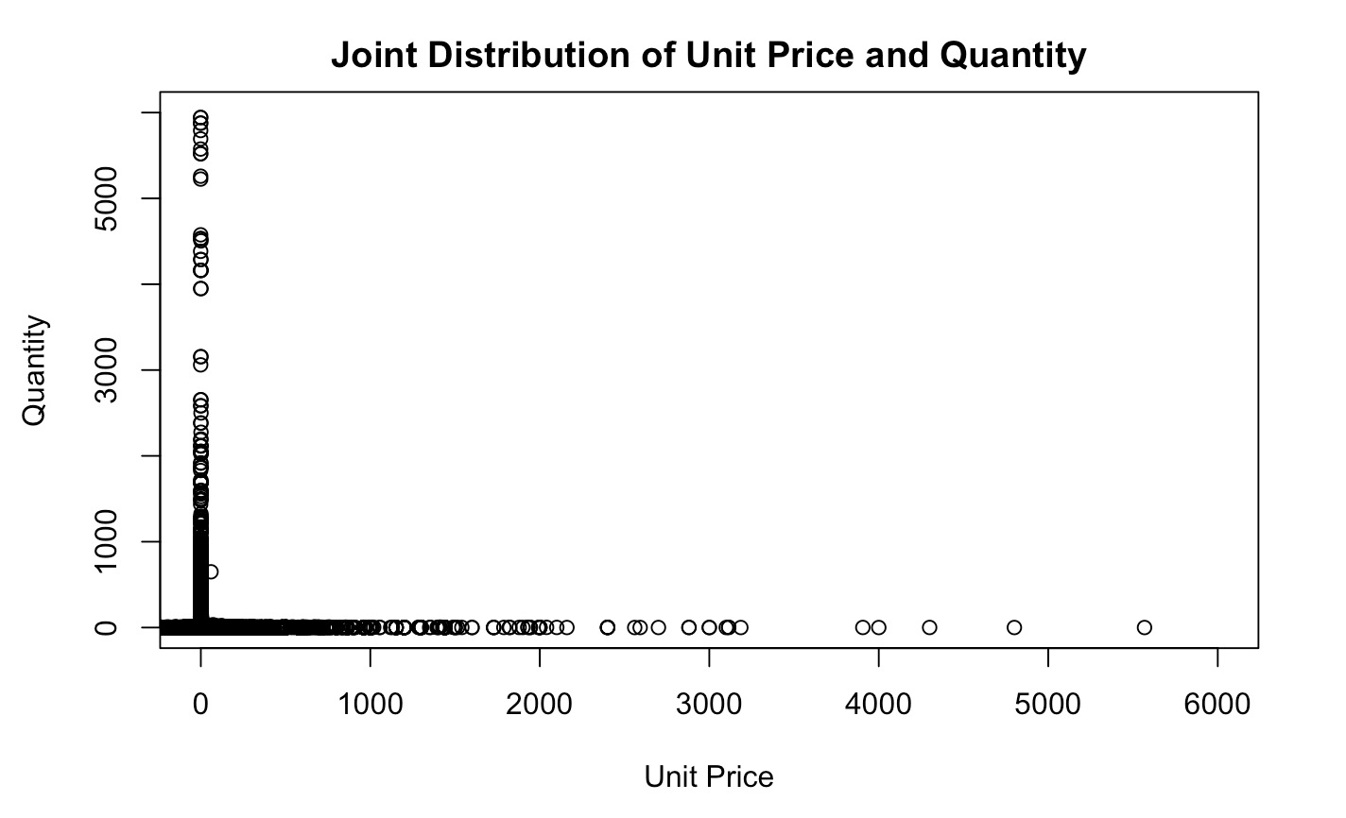
For Unit Price: I expect a larger amount at lower price (ex. 0 ~ 10 dollars) and a smaller amount at higher price;
From Plot: Almost all data are located between 0~25 dollar. This distribution plot seems like a Laplace Distribution's right side with a drastical decay rate.
For Quantity: I expect a larger amount for cheaper price items and a smaller amount for more expensive items;
From Plot: The plot confirms my guess: around zero the purchase quantity is really high, and as the price increases, the quantity decrease(sharply). We can say that the purchase quantity of items priced around zero can not be compared with those higher than zero to the same scale.

Slide 5
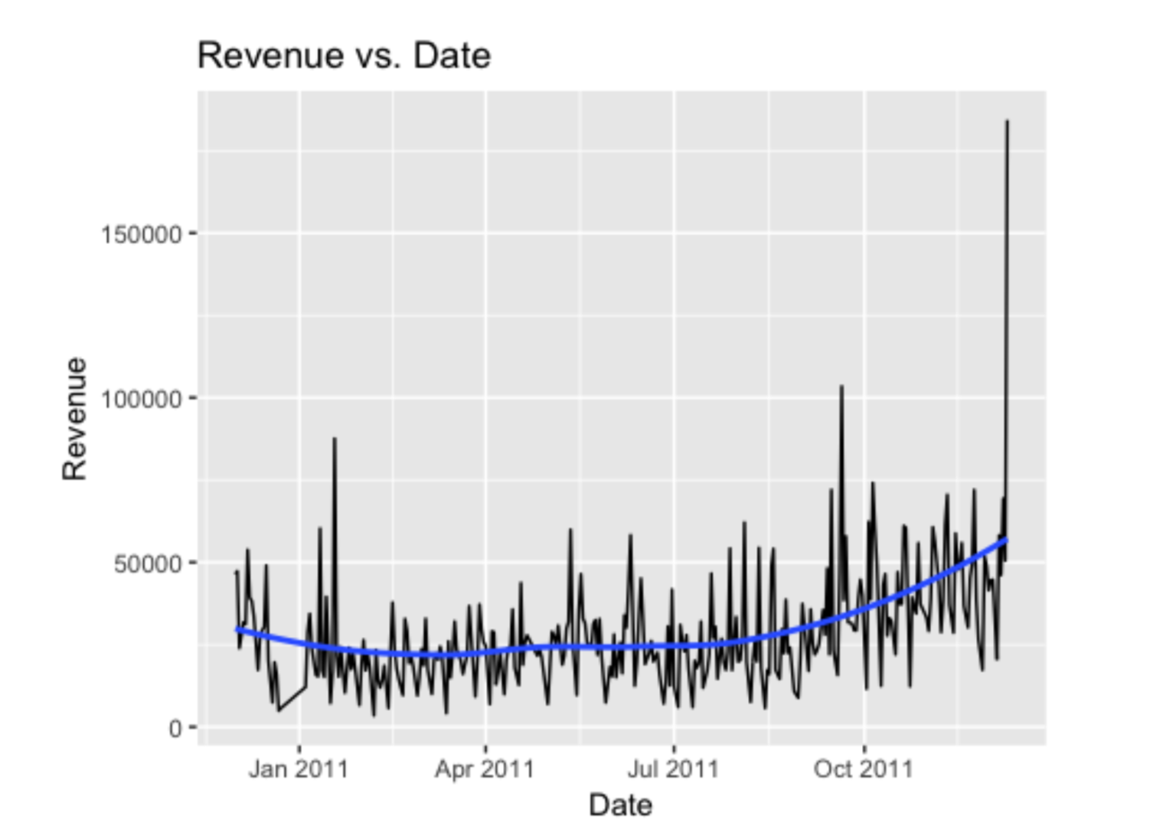
EDA ON Time
Sales Amount General Trend

Slide 6
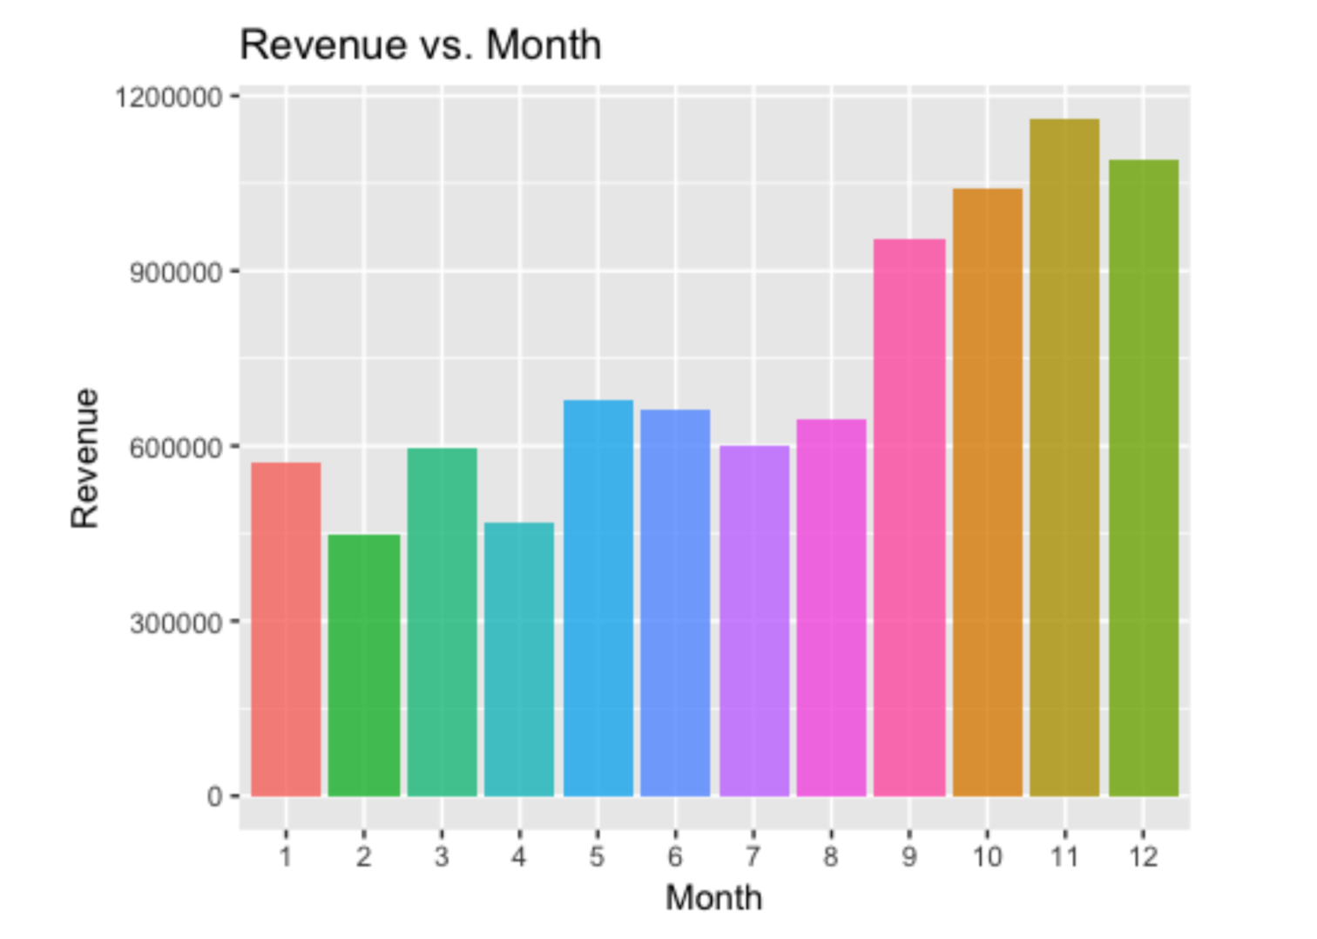
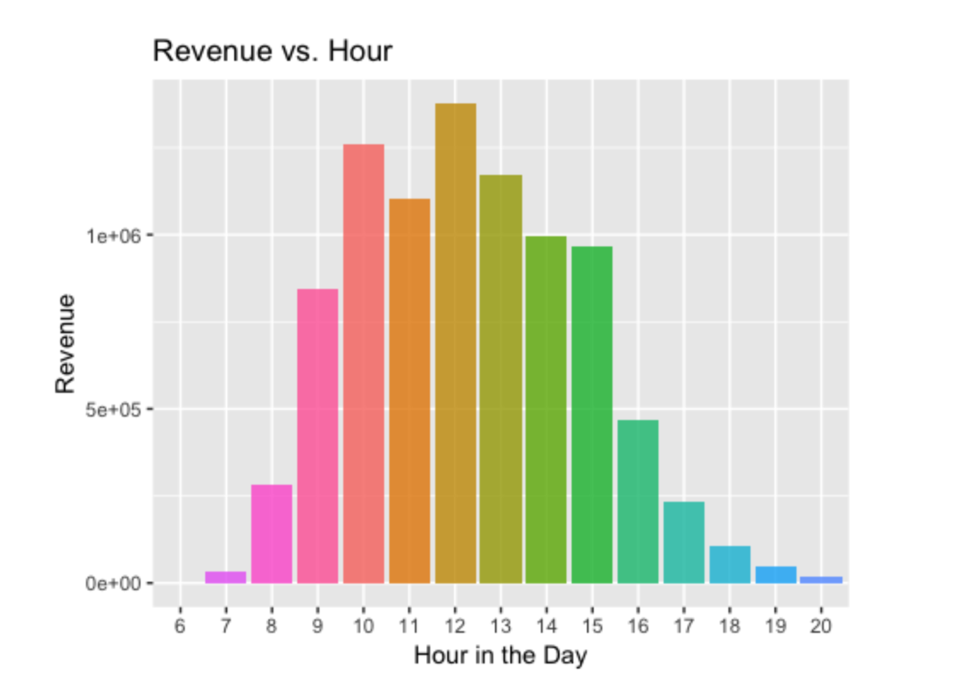
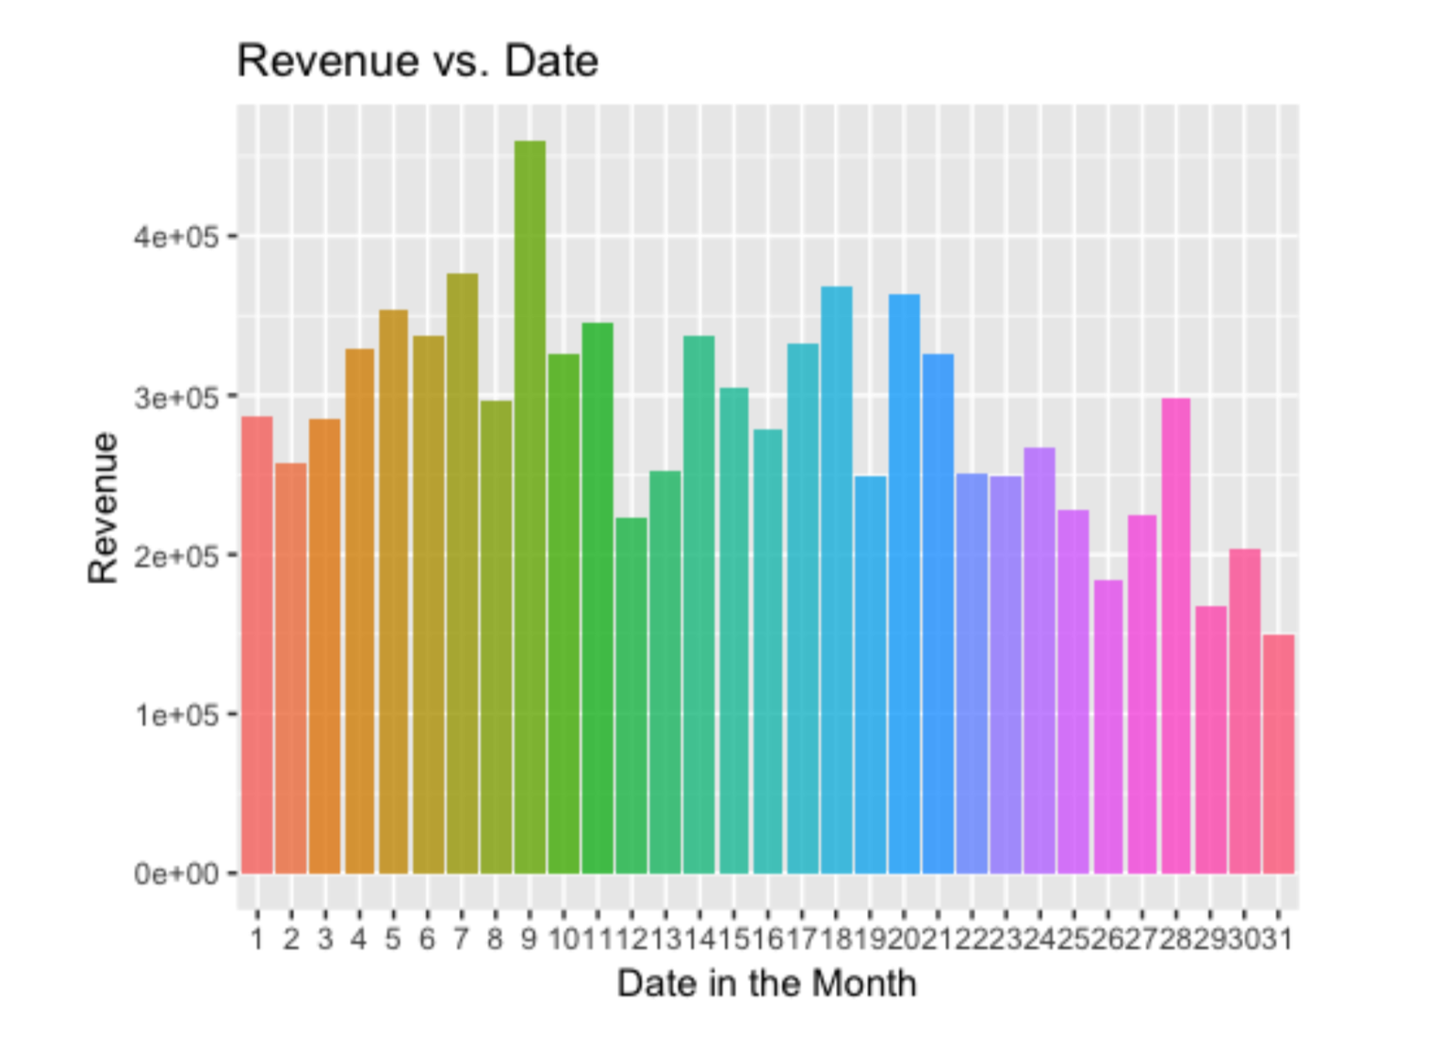
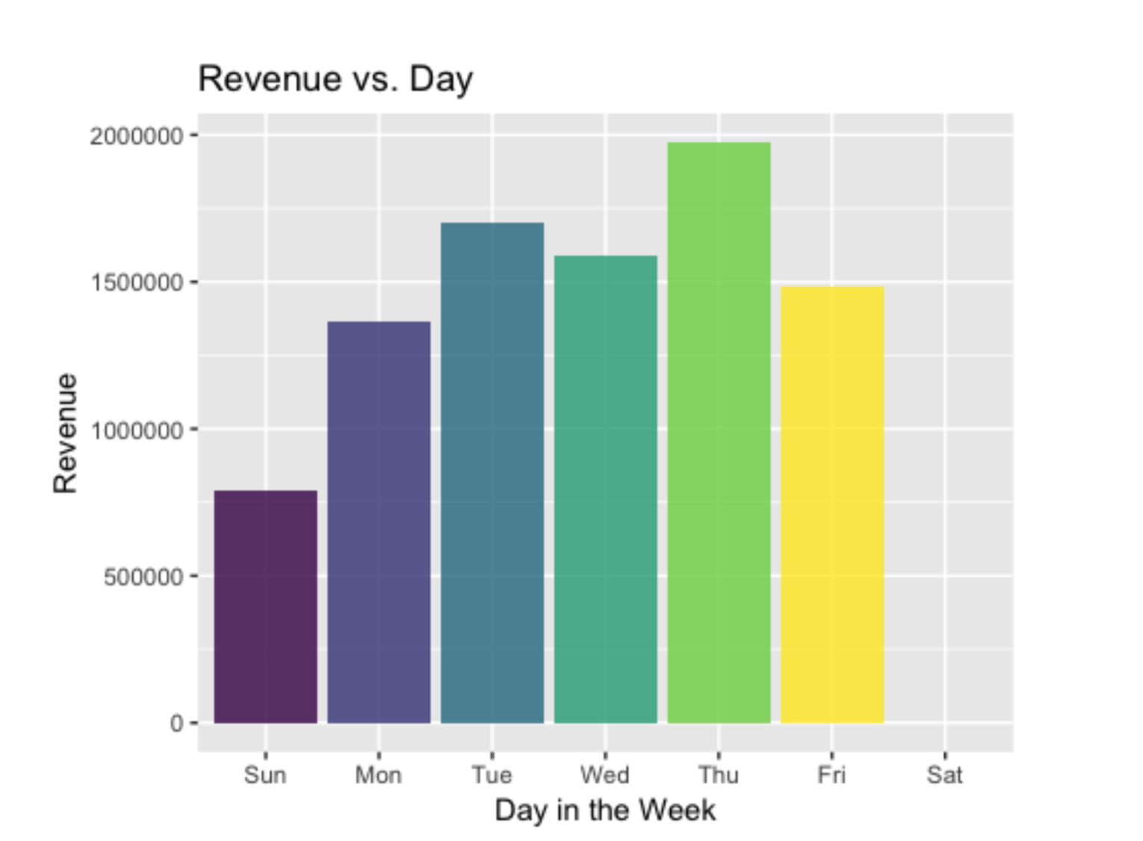

Slide 7
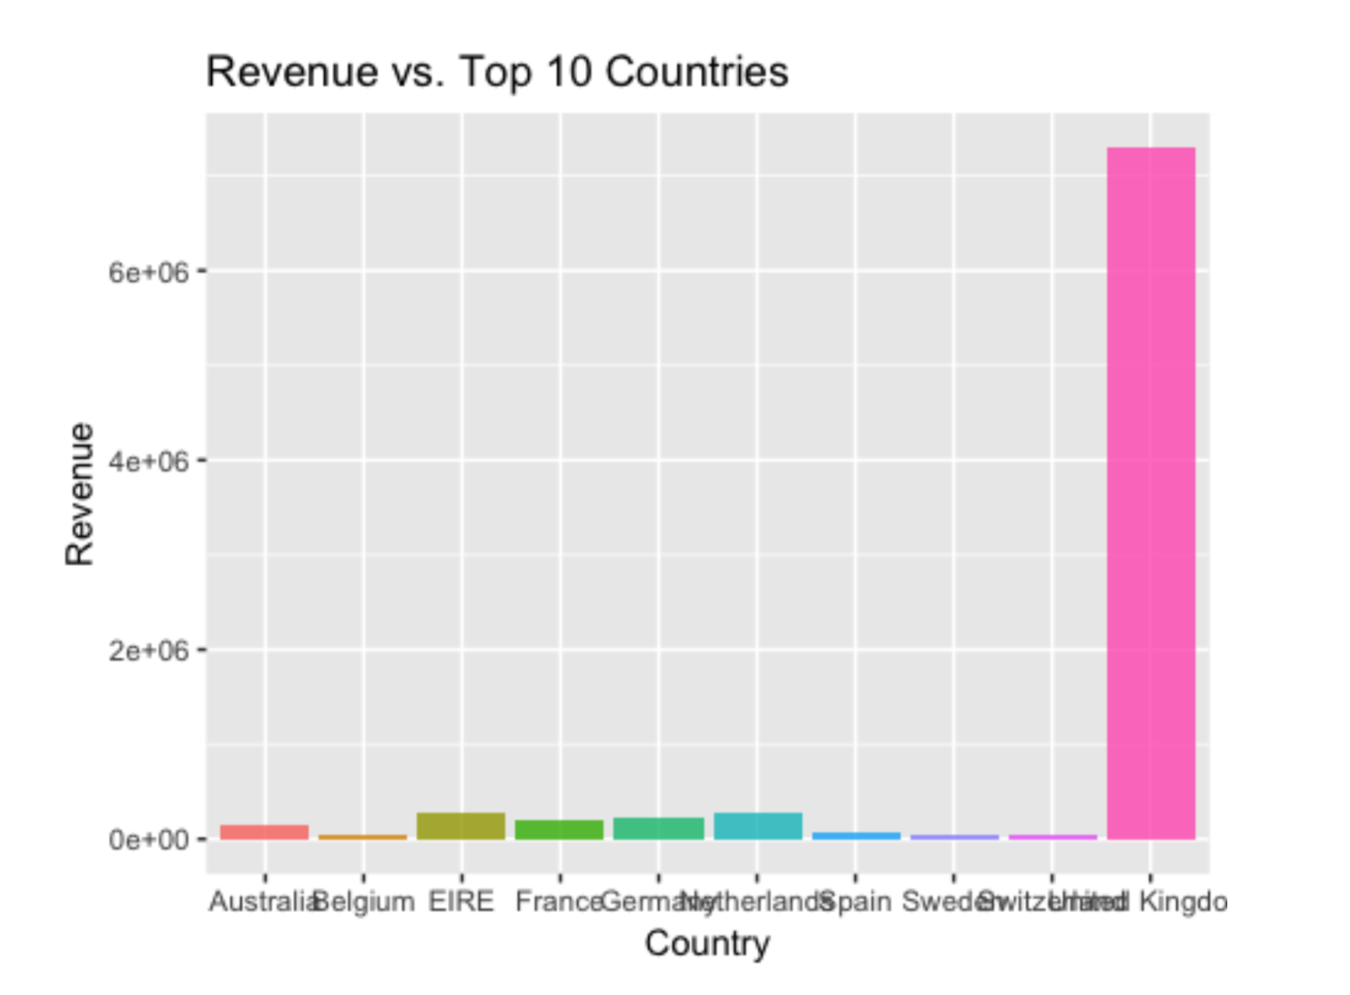
EDA on country
United Kingdom has a dominant place.

Slide 8
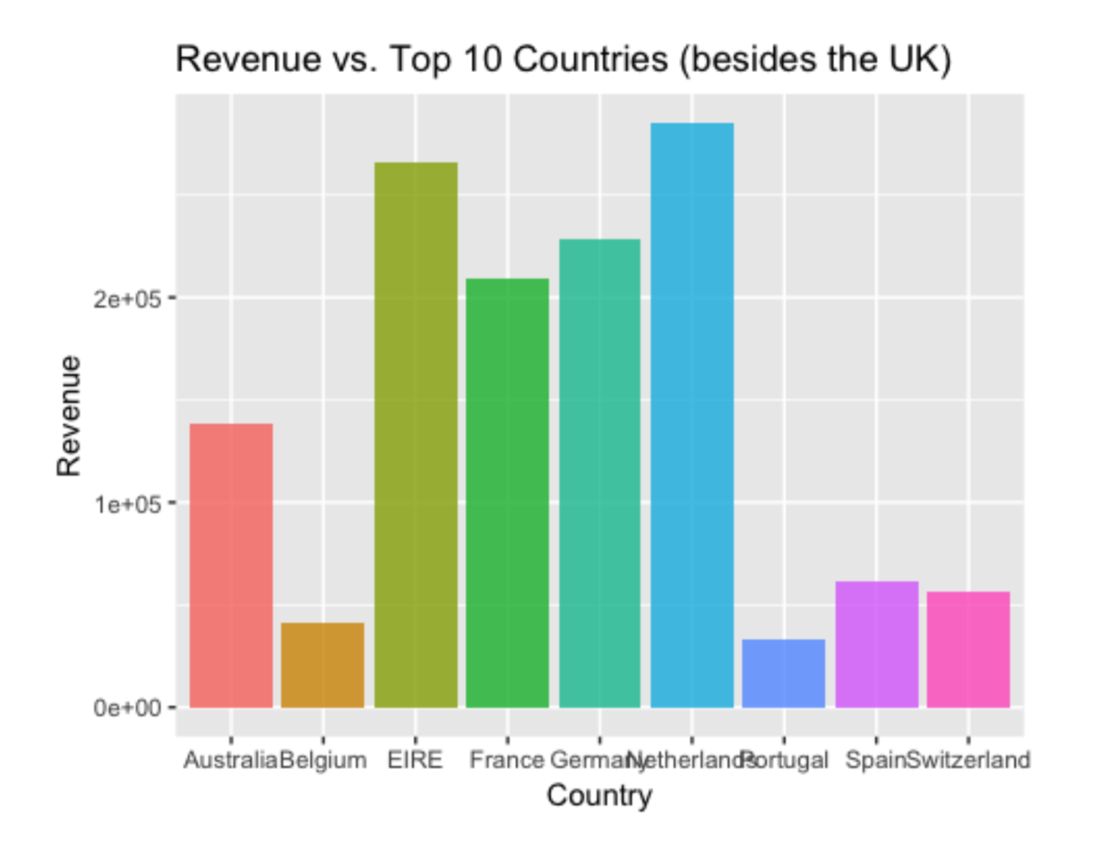
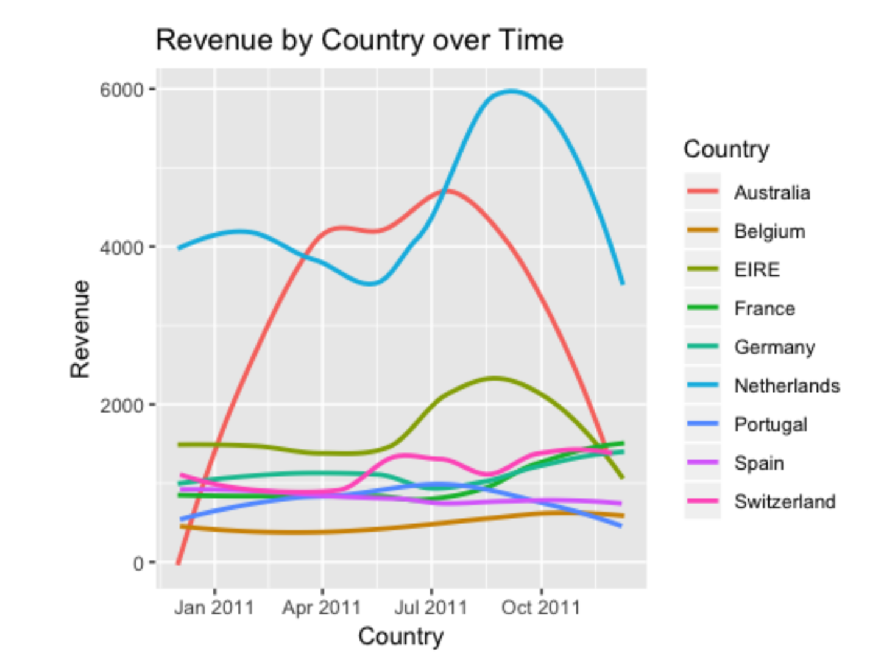

Slide 9
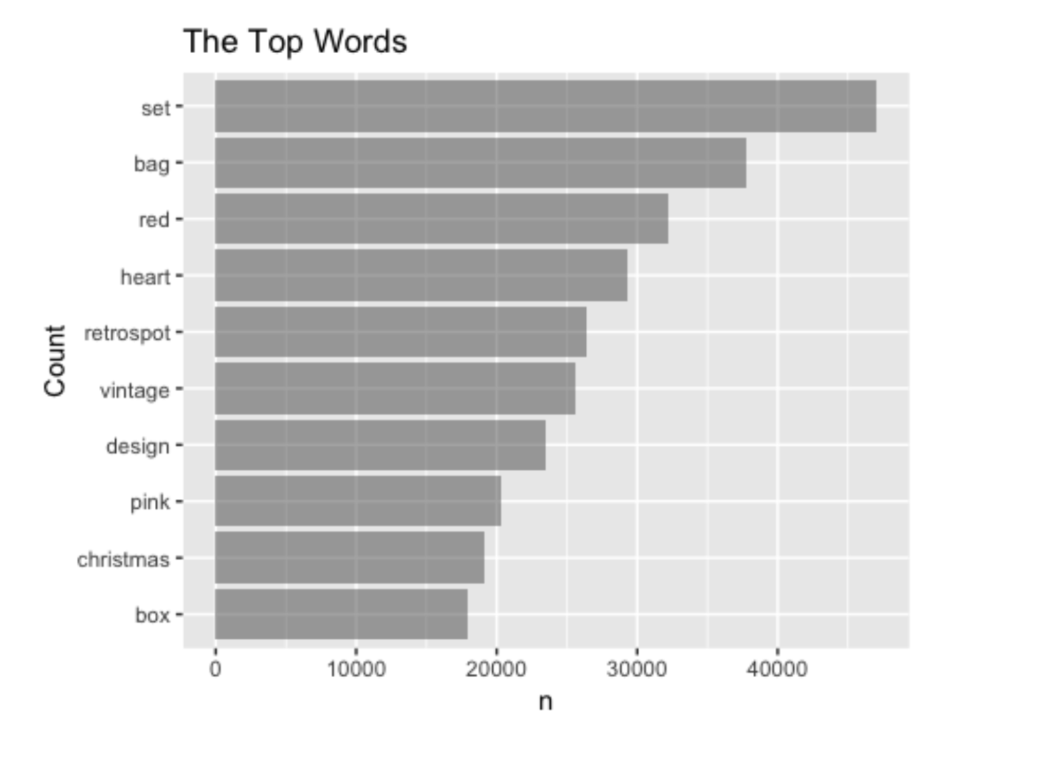

Text analysis on item descriptions

Slide 10
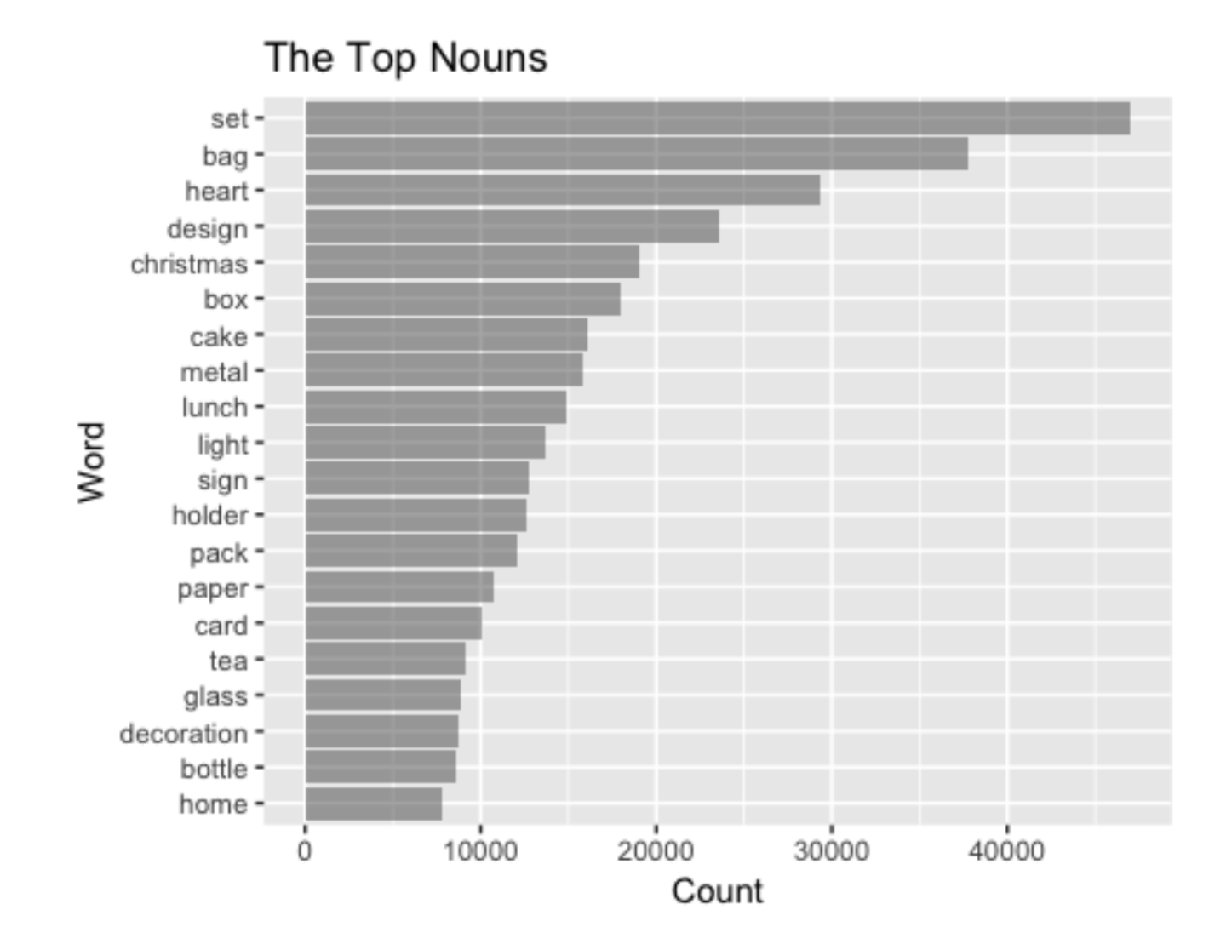


Slide 11
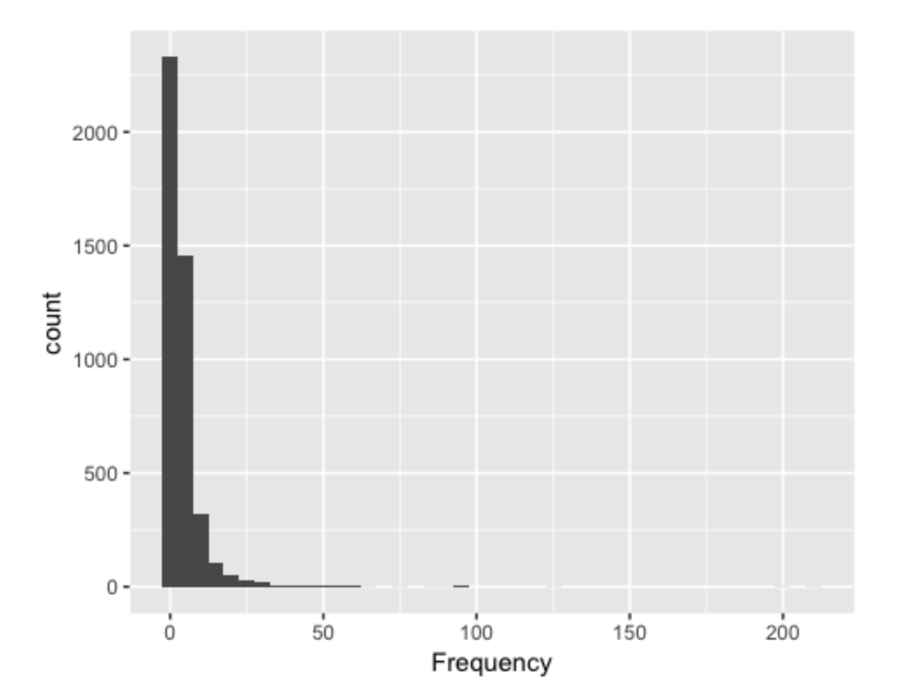
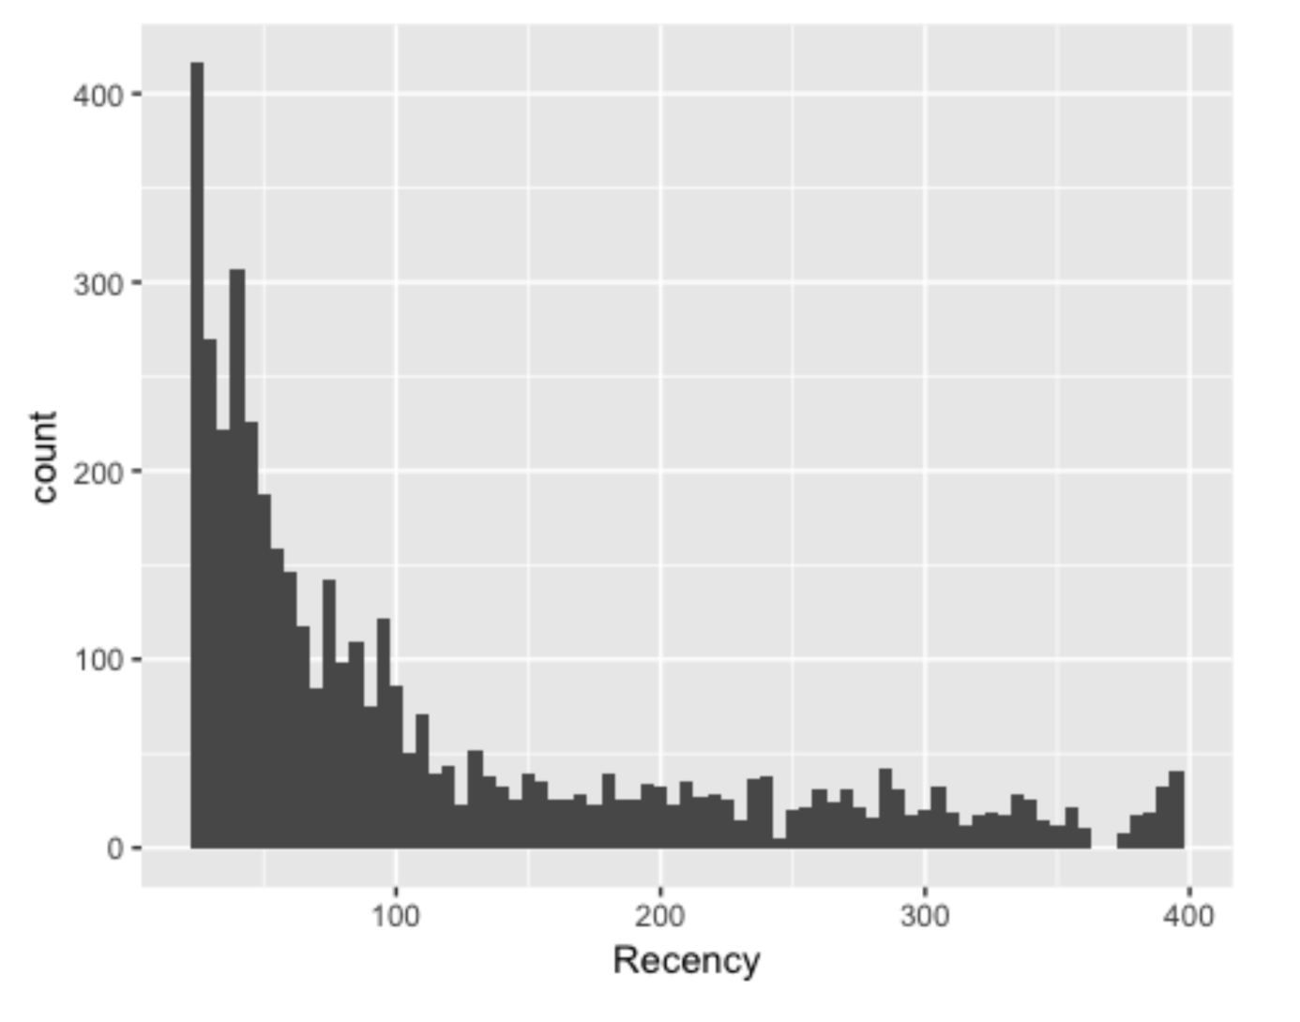
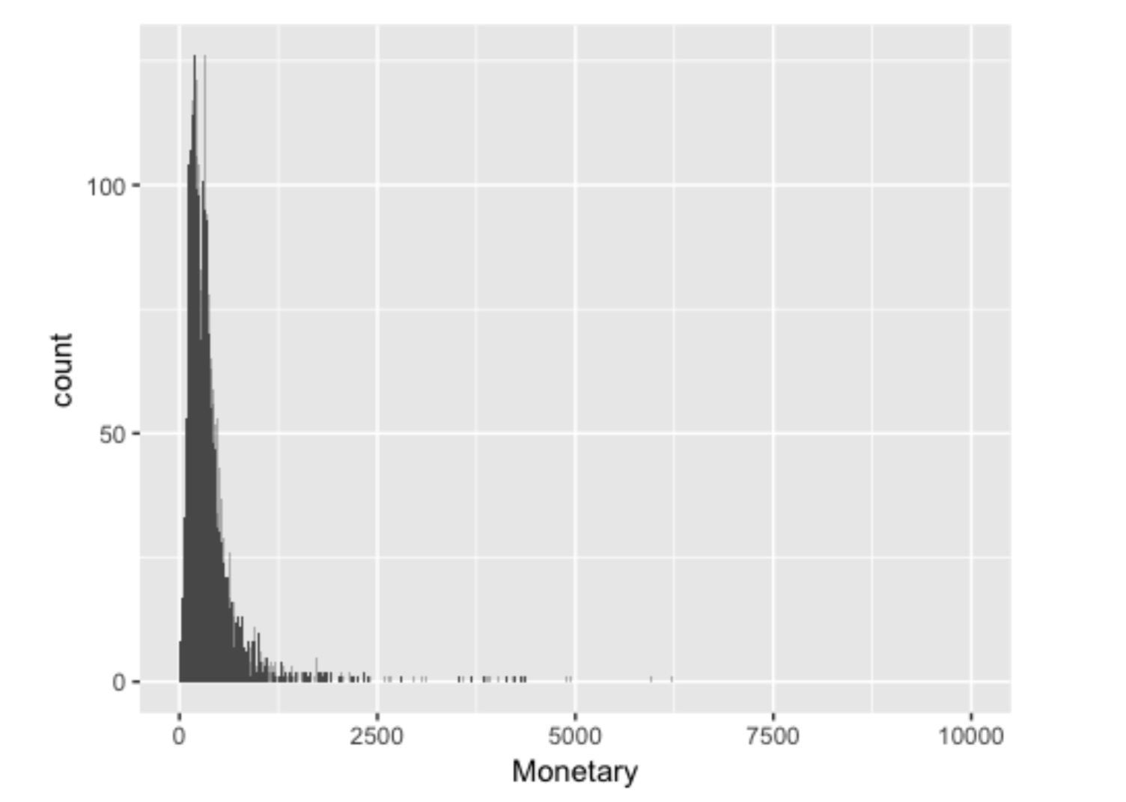
Marketing analysis – RFM analysis

Slide 12
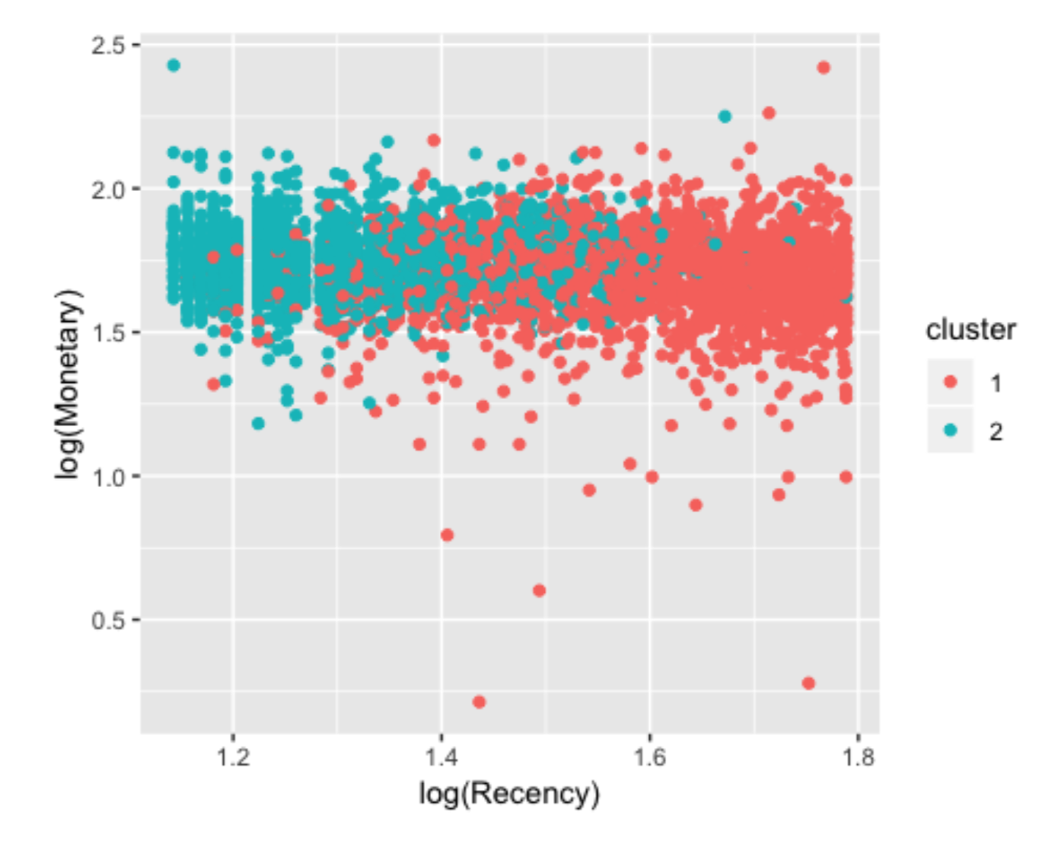
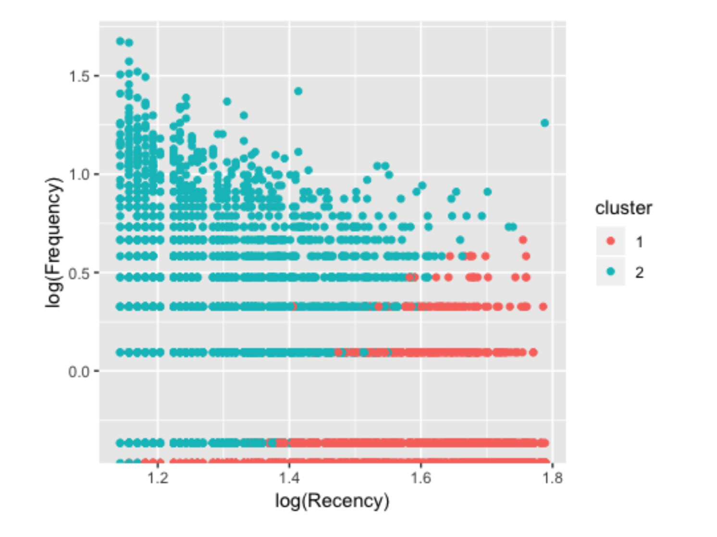
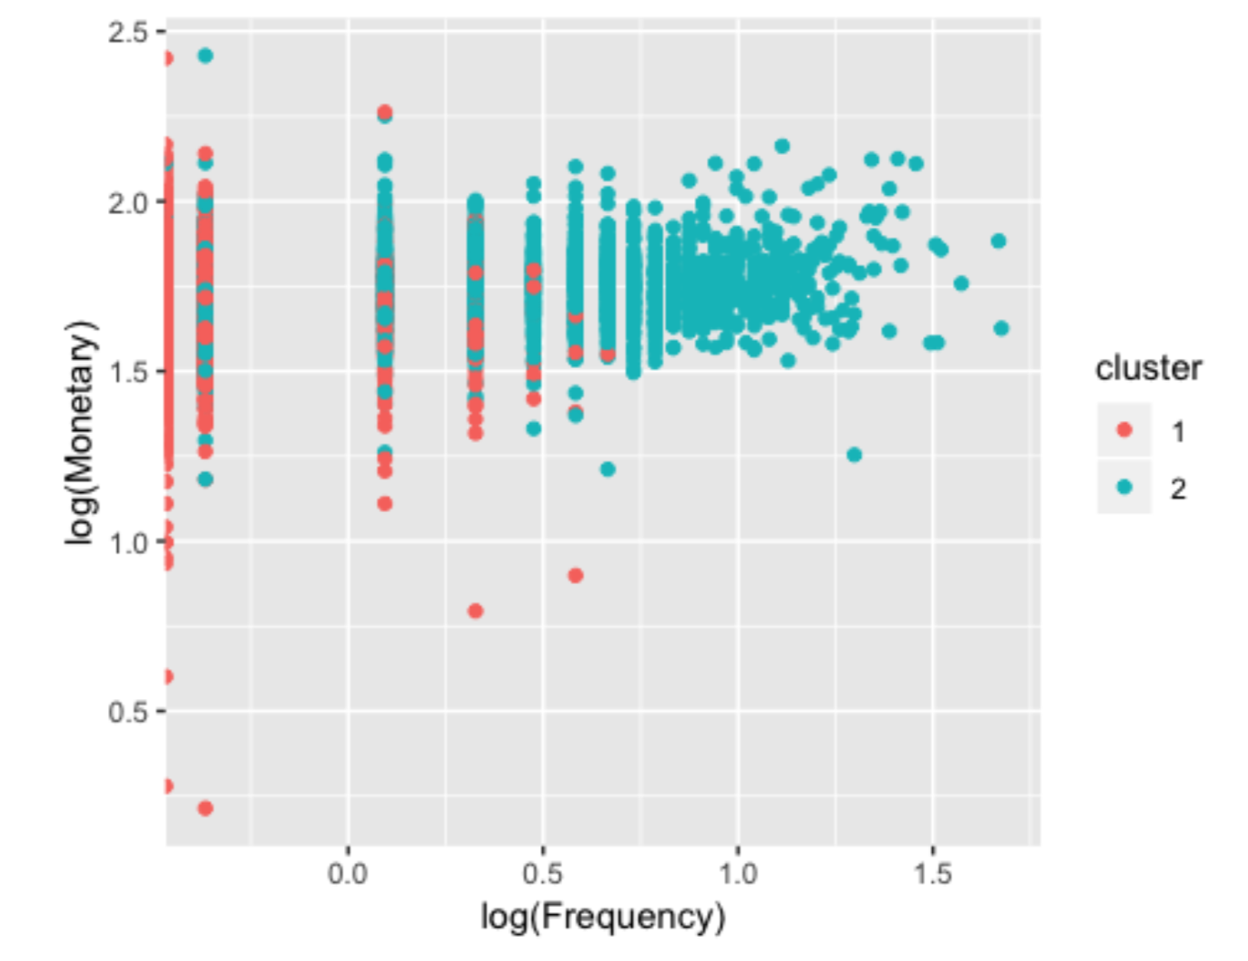
Marketing analysis -- clustering
Using KMEANS

Slide 13
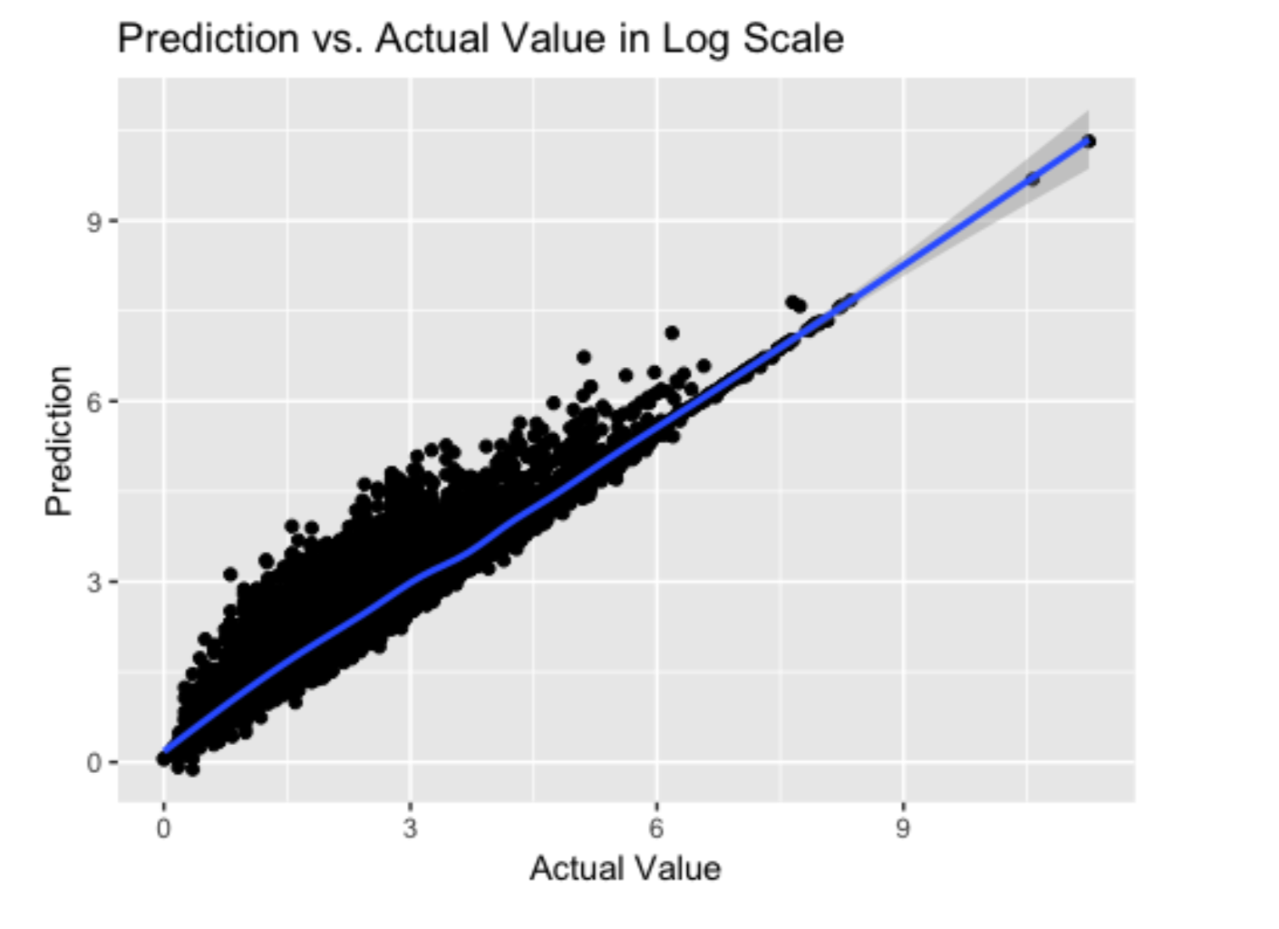
Modeling – linear model
I’ve implemented a classic linear model to explain the total spend for each customer, with their RFM values. I’ve done log transformations for each of them in order to adjust the right-skewness. This model is fairly good at first look, with a high R-square value. But as for residual plot, a clear pattern is shown.

